Slide 1


Info 2602 Project
By
Damian jawahir 814005674
Nicholas Crichlow 815008933
Matthew CYRUS 816000799
LIAM GILBERT 813004117
SHILISHA LOPEZ 816008409

Slide 2
What’s The problem and the solution
With Web development and in web applications there is the problem where by errors can occur and those individuals do not know the first steps in solving it.
The Solution we developed is a system for error messages whereby administrators and developers can better communicate with customers where by a customer gives an error or problem in which they experienced.

Slide 3

What is our project?
We Remodeled Discord to make it a repository for easier communication between customers and Administrators
The developers can then look at a database and look at serious or the most common issues or unsolved issues and decide how to go about resolving the issues which users experience.

Slide 4
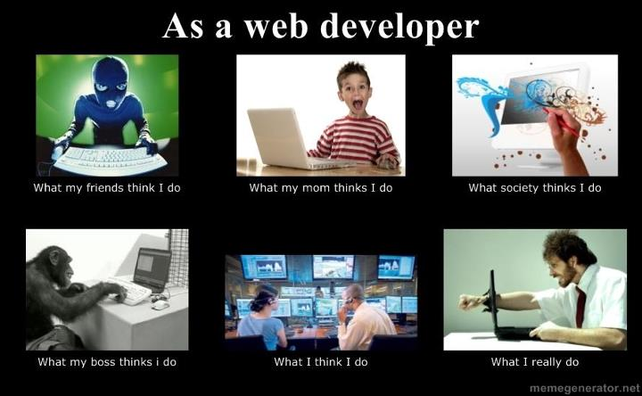
Thank You for Lending us your Ear, Questions ??

